Slide 1
Thermochemistry
Understanding Heats of Reaction
Energy and Its Units
Heat of Reaction
Enthalpy and Enthalpy Change
Thermochemical Equations
Applying Stoichiometry to Heats of Reaction
Measuring Heats of Reaction
Using Heats of Reaction
Hess’s Law
Standard Enthalpies of Formation
Fuels—Foods, Commercial Fuels, and Rocket Fuels

Slide 2
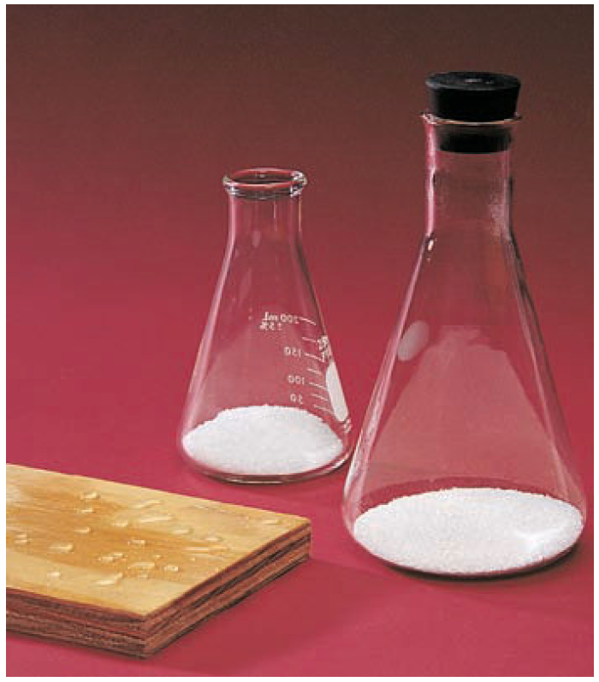
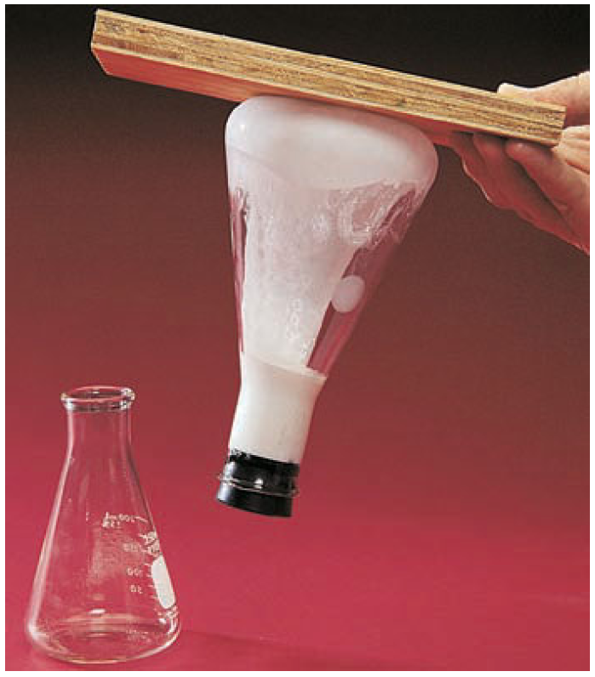
Thermochemistry
After Reaction

Slide 3
Understanding Heats of Reaction
Thermodynamics is the science of the relationships between heat and other forms of energy.
Thermochemistry is one area of thermodynamics. It concerns the study of the quantity of heat absorbed or evolved (given off) by chemical reactions.

Slide 4
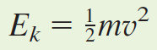
Energy and Its Units
We can define energy briefly as the potential or capacity to move matter. According to this definition, energy is not a material thing but rather a property of matter. Energy exists in different forms that can be interconverted.
Kinetic Energy:
Kinetic energy is the energy associated with an object by virtue of its motion. An object of mass m and speed or velocity v has kinetic energy E_{k} equal to
This formula shows that the kinetic energy of an object depends on both its mass and its speed. A heavy object can move more slowly than a light object and still have the
same kinetic energy.

Slide 5
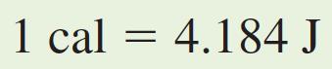
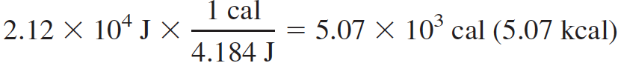
Energy and Its Units
Consider the kinetic energy of a person whose mass is 59.0 kg and whose speed is 26.8 m/s. (This is equivalent to a person with a mass of 130 lb traveling in an automobile going 60 miles per hour.) You substitute the mass and speed into the formula.
The calorie (cal) is a non-SI unit of energy commonly used by chemists, originally defined as the amount of energy required to raise the temperature of one gram of water by one degree Celsius.
A person weighing 130 lb and traveling 60 miles per hour has a kinetic energy of

Slide 6
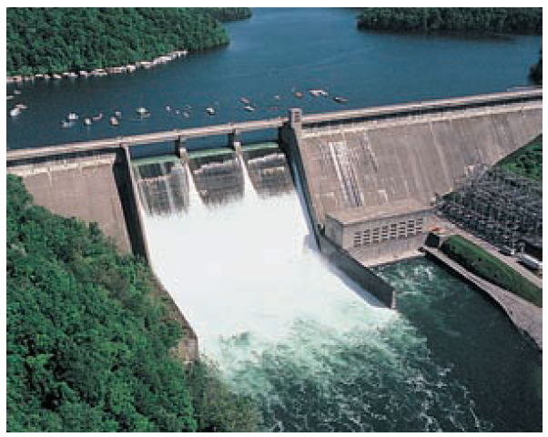
Potential Energy
Potential energy is the energy an object has by virtue of its position in a field of force.
The potential energy of the water is
E_{p} = mgh
Here E_{p} is the potential energy of a quantity of water at the top of the dam, m is the mass of the water, g is the constant acceleration of gravity, and h is the height of the water measured from some standard level.

Slide 7
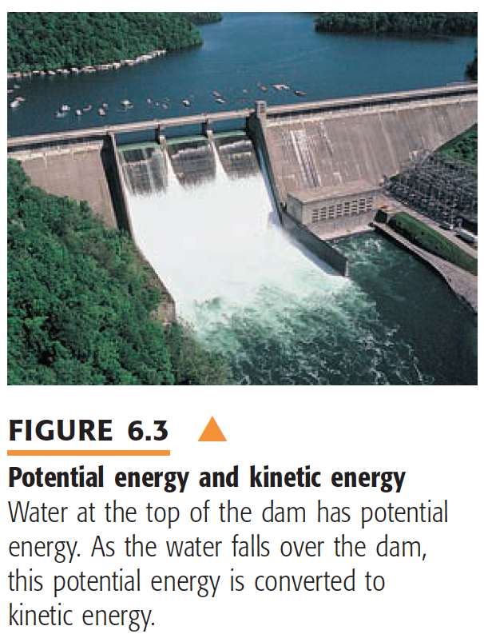
E_{p} = mgh

Slide 8
Internal Energy
The sum of the kinetic and potential energies of the particles making up a substance is referred to as the internal energy, U, of the substance.
Therefore, the total energy, E_{tot}, of a quantity of water equals the sum of its kinetic and potential energies as a whole (E_{k} + E_{p}) plus its internal energy.
E_{tot} = E_{k} + E_{p} + U
Normally when you study a substance in the laboratory, the substance is at rest in a vessel. Its kinetic energy as a whole is zero. Moreover, its potential energy as a whole is constant, and you can take it to be zero. In this case, the total energy of the
substance equals its internal energy, U.

Slide 9
One type of chemical reactions evolve, or release, heat. Other type of reactions absorb heat. Both types of reaction involve a heat of reaction.
Suppose that you are interested in studying the change of a thermodynamic property (such as internal energy) during a physical or chemical change. The substance or mixture of substances under study in which a change occurs is called the thermodynamic system (or simply system). The surroundings are everything in the vicinity of the thermodynamic system.

Slide 10
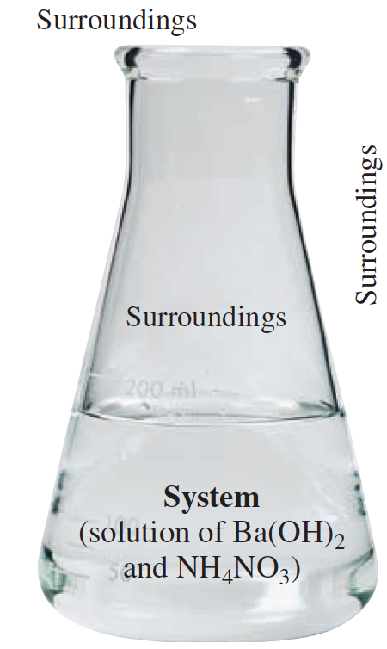
Heat & Thermodynamic System
Heat is defined as the energy that flows into or out of a system because of a difference in temperature between the thermodynamic system and its surroundings.
As long as a system and surroundings are in thermal contact, energy (heat) flows between them to establish temperature equality, or thermal equilibrium.
Heat flows from a region of higher temperature to one of lower temperature; once the temperatures become equal, heat flow stops.

Slide 11
Heat of Reaction
The heat of reaction (at a given temperature) is the value of q required to return a system to the given temperature at the completion of the reaction.
Chemical reactions or physical changes are classified as exothermic or endothermic.
An exothermic process is a chemical reaction or a physical change in which heat is evolved (q is negative).
An endothermic process is a chemical reaction or a physical change in which heat is absorbed (q is positive).
Experimentally, in the exothermic reaction, the reaction flask initially warms; in the endothermic reaction, the reaction flask initially cools.

Slide 12
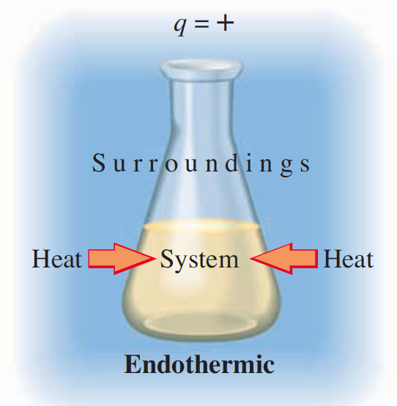
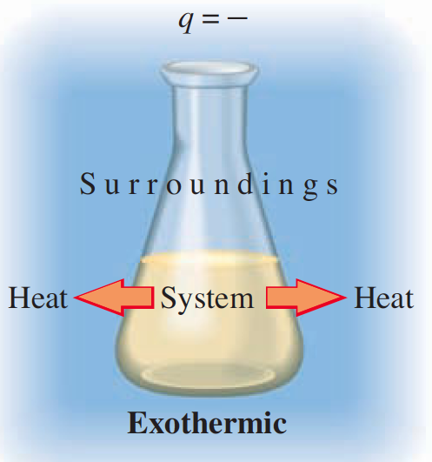
Heat of Reaction

Slide 13
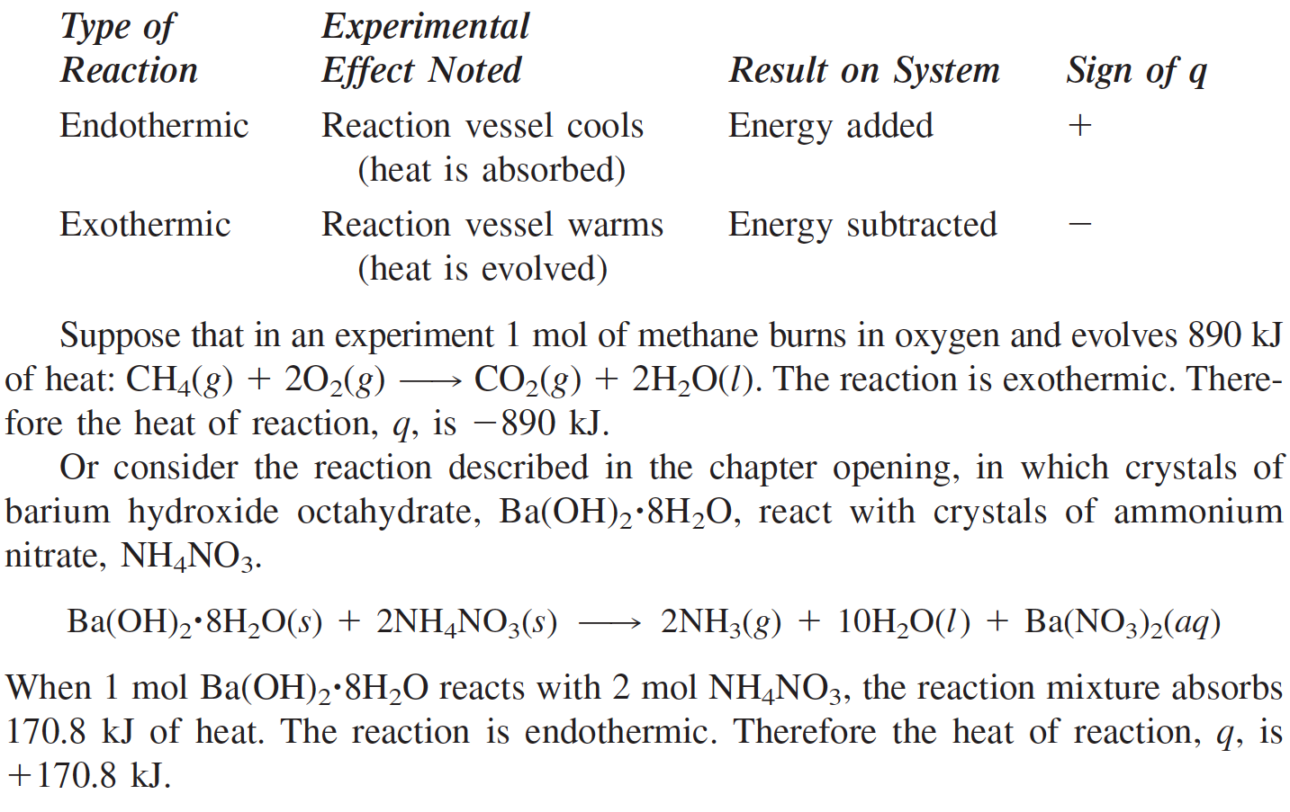
Heat of Reaction

Slide 14
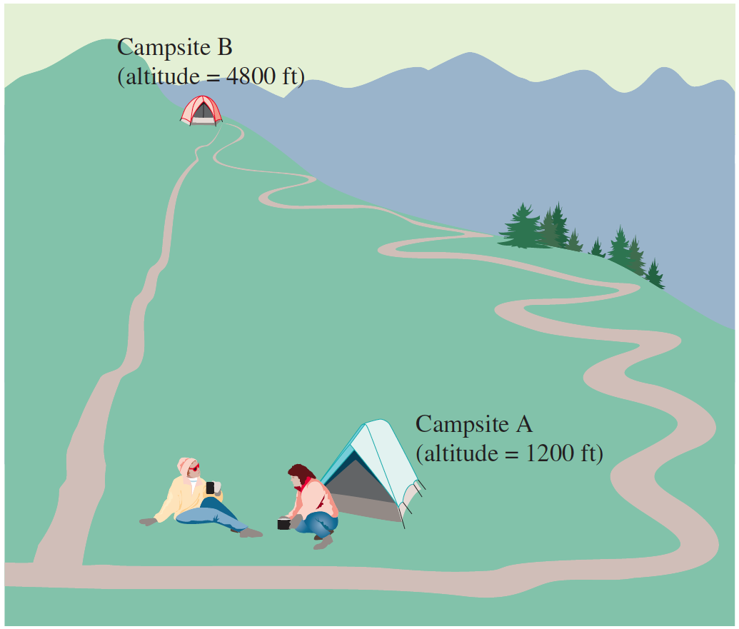
Enthalpy
There is a property of substances called enthalpy that is related to the heat of reaction q_{p}. Enthalpy (denoted by H) is an extensive property of a substance that can be used to obtain the heat absorbed or evolved in a chemical reaction.
Enthalpy is an extensive property. An extensive property is a property that depends on the amount of substance. Other examples of extensive properties are mass and volume.
Enthalpy is a state function. A state function is a property of a system that depends only on its present state, which is determined by variables such as temperature and pressure, and is independent of any previous history of the system. This means that a
change in enthalpy does not depend on how the change was made, but only on the
initial state and final state of the system.

Slide 15
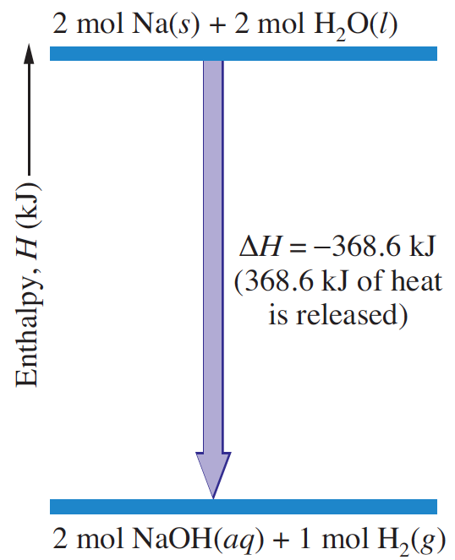
Enthalpy of Reaction
The change in enthalpy, ΔH, for a reaction at a given temperature and pressure (called the enthalpy of reaction) is obtained by subtracting the enthalpy of the reactants from the enthalpy of the products.
ΔH = H_{final} - H_{initial}.
Since you start from reactants and end with products, the enthalpy of reaction is
ΔH = H(products) - H(reactants)
Because H is a state function, the value of ΔH is independent of the details of the reaction. It depends only on the initial state (the reactants) and the final state (the products).

Slide 16
Enthalpy of Reaction
The enthalpy of reaction equals the heat of reaction at constant pressure.
ΔH = q_{p}
To illustrate the concepts we have introduced, consider the reaction at 25°C of sodium metal and water, carried out in a beaker open to the atmosphere at 1.00 atm pressure.
2Na(s) + 2H₂O(l ) = 2NaOH(aq) + H₂(g)
2 mol of sodium metal reacts with 2 mol of water to evolve 368.6 kJ of heat. Because heat evolves, the reaction is exothermic, and you write q_{p} = -368.6 kJ.
So, the enthalpy of reaction, or change of enthalpy for the reaction, is ΔH = -368.6 kJ.

Slide 17
Enthalpy & Internal Energy
The enthalpy, H, is defined precisely as the internal energy, U, plus pressure, P, times volume, V.
H = U + PV
Consider a reaction system at constant pressure P. We will label the initial quantities (those for reactants) with a subscript i and the final quantities (those for products) with a subscript f. Then
ΔH = H_{f} – H_{i} = (U_{f} + PV_{f}) – (U_{i} + PV_{i})
Or, ΔH = (U_{f} – U_{i}) + P(V_{f} – V_{i}) = ΔU + PΔV
Or, ΔU = ΔH – PΔV
The last term in this equation (–PΔV) is the energy required by the system to change volume against the constant pressure of the atmosphere. This required energy is called the pressure–volume work.
The internal energy of the system changes because energy leaves or enters the system as heat (ΔH), and because the system increases or decreases in volume against the constant pressure of the atmosphere (−PΔV).

Slide 18
Enthalpy & Internal Energy
Consider a specific reaction. When 2 mol of sodium metal and 2 mol of water react in a beaker, 1 mol of hydrogen gas forms and heat evolves. If you measured this heat, you would find it to be −368.6 kJ, indicating that 368.6 kJ of energy has left the system in the form of heat.
Because hydrogen gas forms during the reaction, the volume of the system
increases. To expand, the system must push back the atmosphere, and this requires energy equal to the pressure–volume work. It may be easier to see this pressure–volume work if you replace the constant pressure of the atmosphere by an equivalent pressure from a piston-and-weight assembly. When hydrogen gas is released during the reaction, it pushes upward on the piston and raises the weight. It requires energy to lift a weight upward in a gravitational field.
Calculate the pressure–volume work. Find out the internal energy of the system.

Slide 19
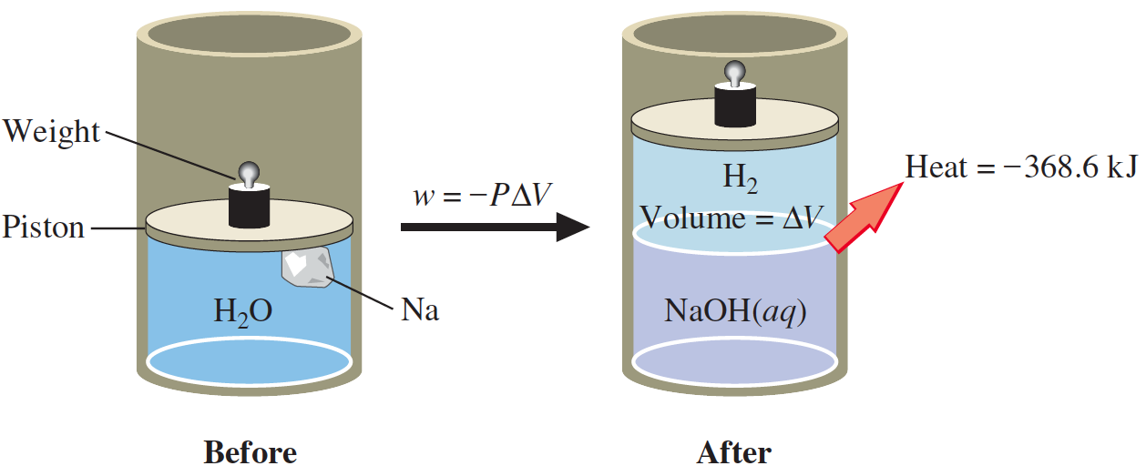
At 25°C and 1.00 atm pressure, you find that it is −PΔV = ΔnRT = −2.5 kJ.
In the sodium–water reaction, the internal energy changes by −368.6 kJ because heat evolves and changes by −2.5 kJ because pressure–volume work is done. The total change of internal energy is ΔU = ΔH − PΔV = −368.6 kJ + 2.5 kJ = −371.1 kJ
ΔU does not differ a great deal from ΔH. This is the case in most reactions, so the heat of reaction at constant pressure is approximately equal to the change of internal energy.

Slide 20
Thermochemical Equations
A thermochemical equation is the chemical equation for a reaction (including phase labels) in which the equation is given a molar interpretation, and the enthalpy of reaction for these molar amounts is written directly after the equation.
For the reaction of sodium and water, you would write
2Na(s) + 2H₂O(l ) ➔ 2NaOH(aq) + H₂(g); ΔH = −368.6 kJ
This equation says that 2 mol of sodium reacts with 2 mol of water to produce 2 mol of sodium hydroxide and 1 mol of hydrogen gas, and 368.6 kJ of heat evolves.

Slide 21
Thermochemical Equations
Thermochemical equation includes phase labels. This is because the enthalpy change, ΔH, depends on the phase of the substances. Consider the reaction of hydrogen and oxygen to produce water. If the product is water vapor, 2 mol of H₂ burn to release 483.7 kJ of heat.
2H₂(g) + O₂(g) ➔ 2H₂O(g); ΔH = −483.7 kJ
On the other hand, if the product is liquid water, the heat released is 571.7 kJ.
2H₂(g) + O₂(g) ➔ 2H₂O(l ); ΔH = −571.7 kJ
In this case, additional heat is released when water vapor condenses to liquid

Slide 22
Thermochemical Equations
When a thermochemical equation is multiplied by any factor, the value of ΔH for the new equation is obtained by multiplying the value of ΔH in the original equation by that same factor.
When a chemical equation is reversed, the value of ΔH is reversed in sign.

Slide 23
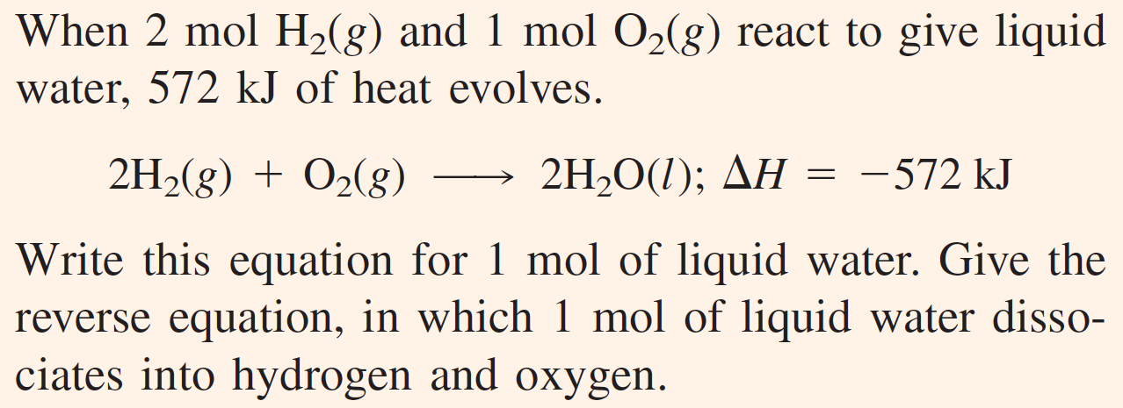
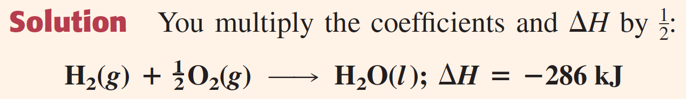
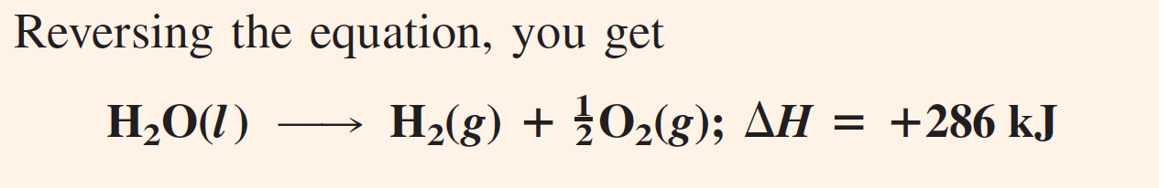

Slide 24
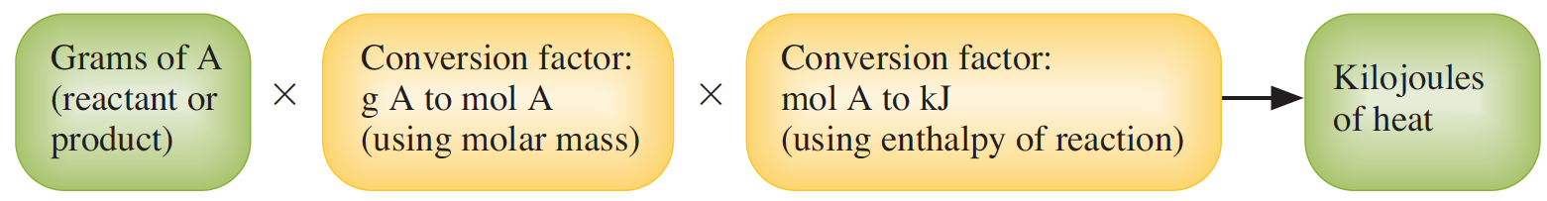
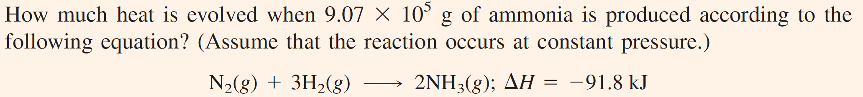

Applying Stoichiometry to Heats of Reaction

Slide 25
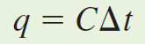
Measuring Heats of Reaction
The heat capacity (C) of a sample of substance is the quantity of heat needed to raise the temperature of the sample of substance one degree Celsius (or one kelvin).
Changing the temperature of the sample from an initial temperature t_{i} to a final temperature t_{f} requires heat equal to
Where Δt is the change of temperature and equals t_{f} − t_{i}. Suppose a piece of iron requires 6.70 J of heat to raise the temperature by one degree Celsius. Its heat capacity is therefore 6.70 J/°C. The quantity of heat required to raise the temperature of the piece of iron from 25.0°C to 35.0°C is q = CΔt = (6.70 J/°C) × (35.0°C - 25.0°C) = 67.0 J.
C is directly proportional to the amount of substance. Often heat capacities are listed for molar amounts of substances. The molar heat capacity of a substance is its heat capacity for one mole of substance.

Slide 26
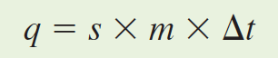
Measuring Heats of Reaction
The specific heat capacity (or simply specific heat) is the quantity of heat required to raise the temperature of one gram of a substance by one degree Celsius (or one kelvin) at constant pressure.
To find the heat q required to raise the temperature of a sample, you
multiply the specific heat of the substance, s, by the mass in grams,
m, and the temperature change, Δt.
The specific heats and molar heat capacities of substances depend somewhat on temperature. Water has a specific heat of 4.18 J/(g•°C) —that is, 4.18 joules per gram per degree Celsius. In terms of calories, the specific heat of water is 1.00 cal/(g•°C).

Slide 27
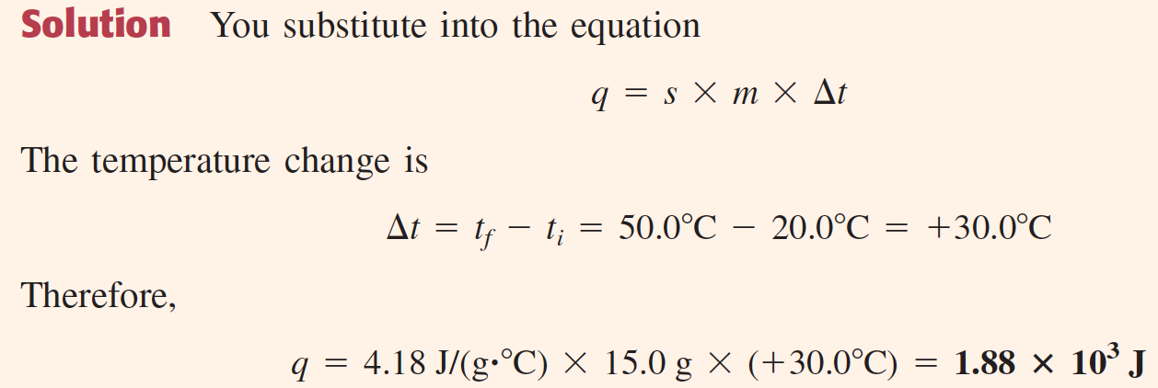
Measuring Heats of Reaction

Slide 28
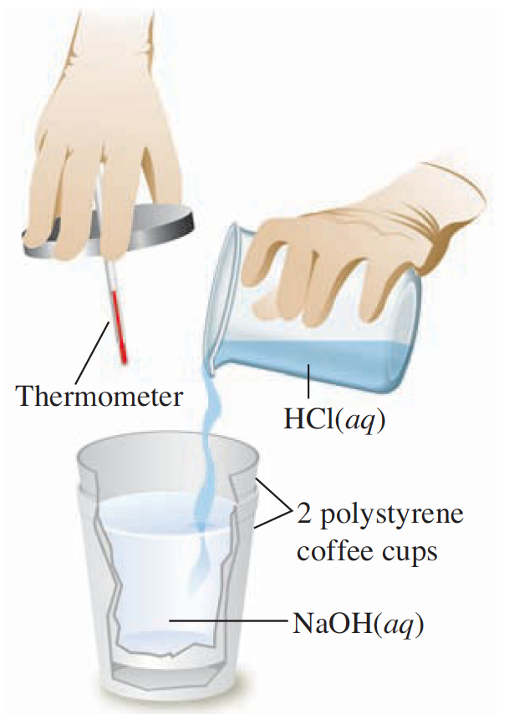
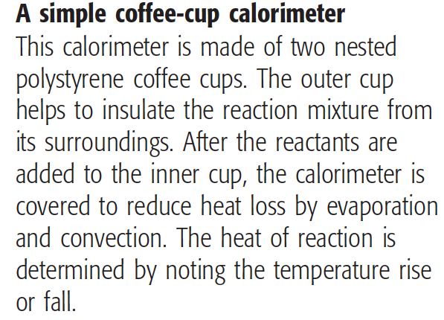
Calorimeter

Slide 29
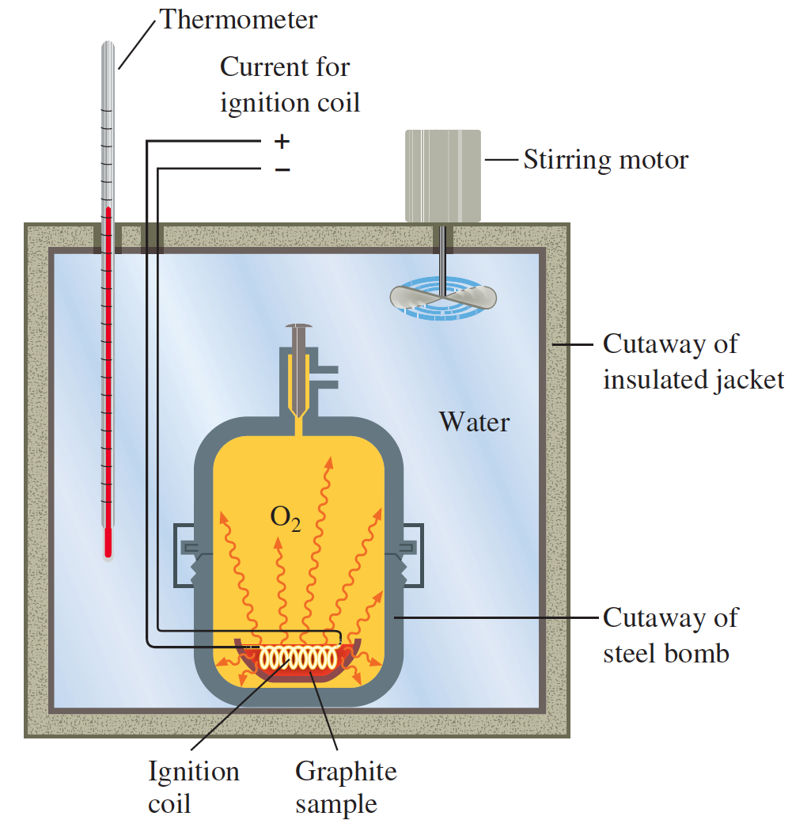
Calorimeter
A bomb calorimeter
This type of calorimeter can be used to determine the heat of combustion of a substance. The figure shows a sample of graphite being burned in oxygen within a vessel called the bomb. An electric current passing through the ignition coil starts the graphite burning. The temperature of the water surrounding the bomb rises as heat flows from the exothermic reaction of graphite and oxygen.

Slide 30
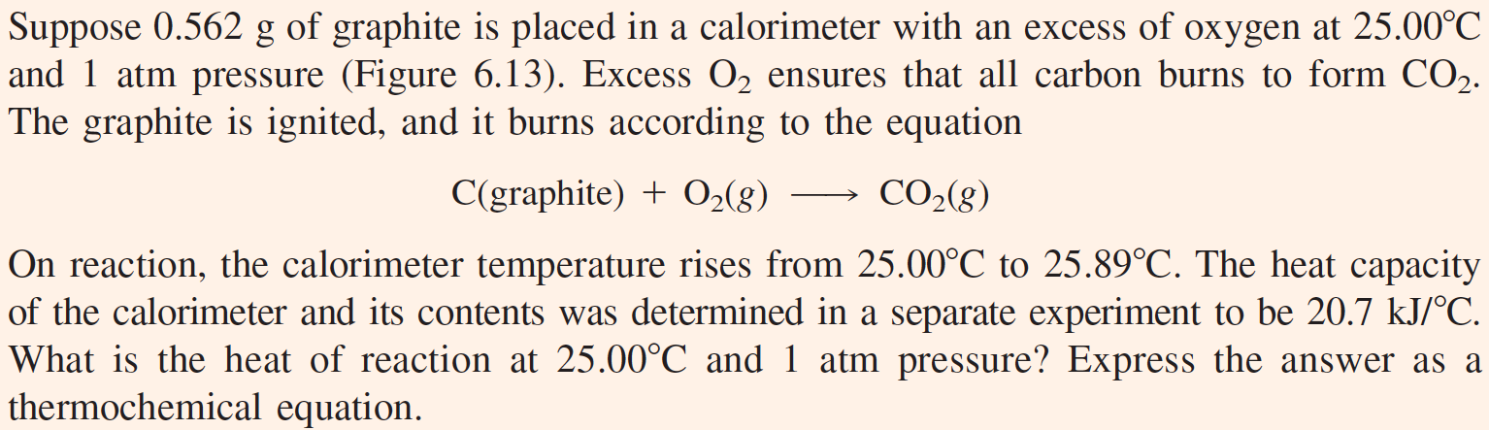
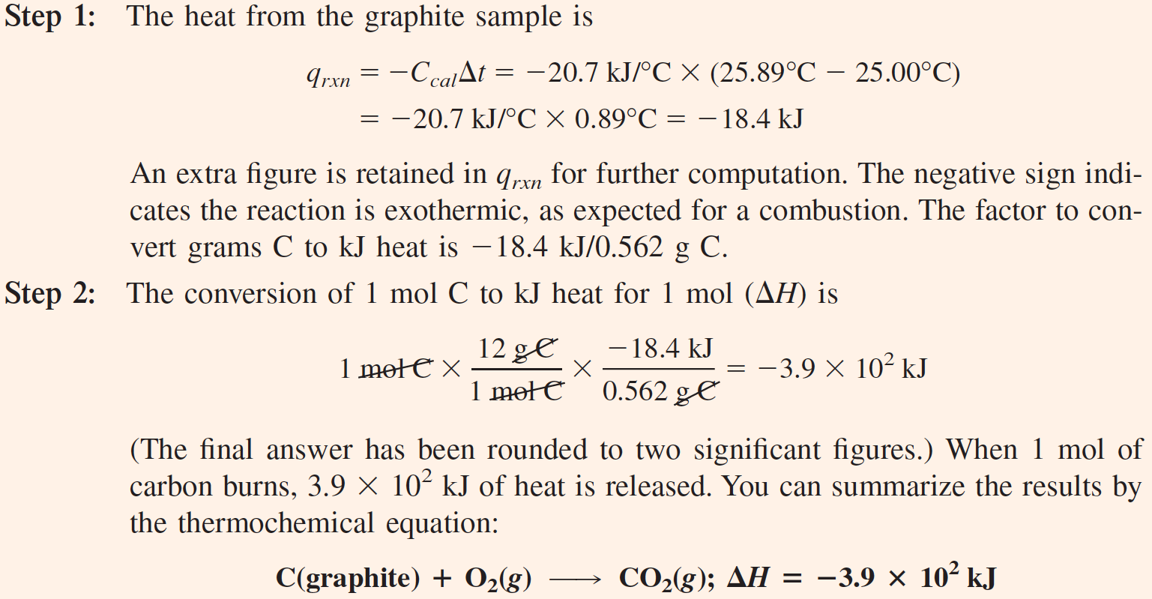

Slide 31
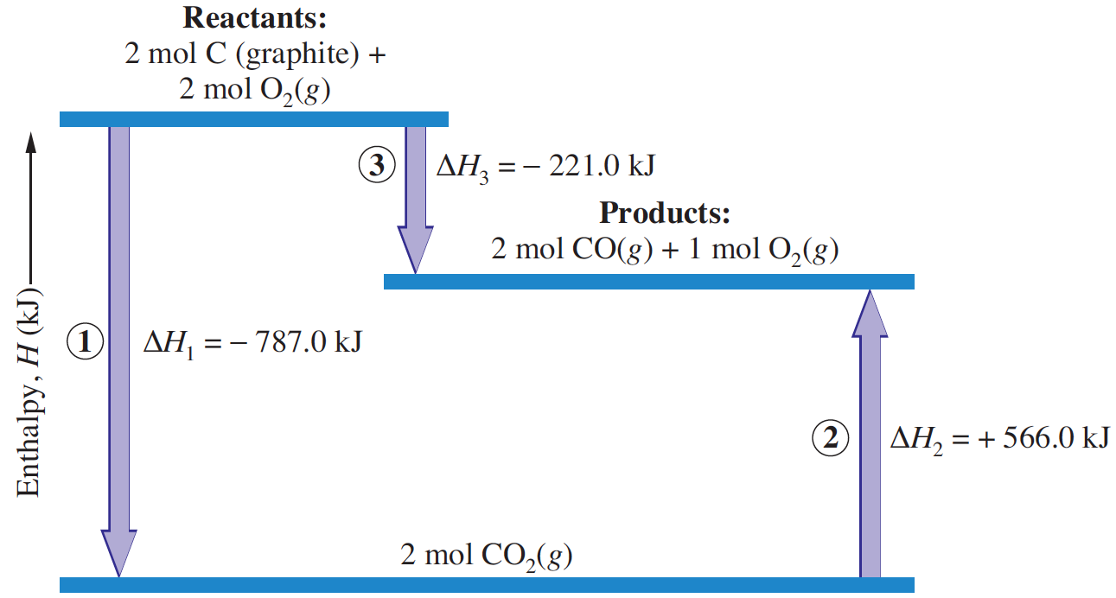
Hess’s Law
Hess’s law of heat summation states that for a chemical equation that can be written as the sum of two or more steps, the enthalpy change for the overall equation equals the sum of the enthalpy changes for the individual steps.
ΔH₂ = ?

Slide 32
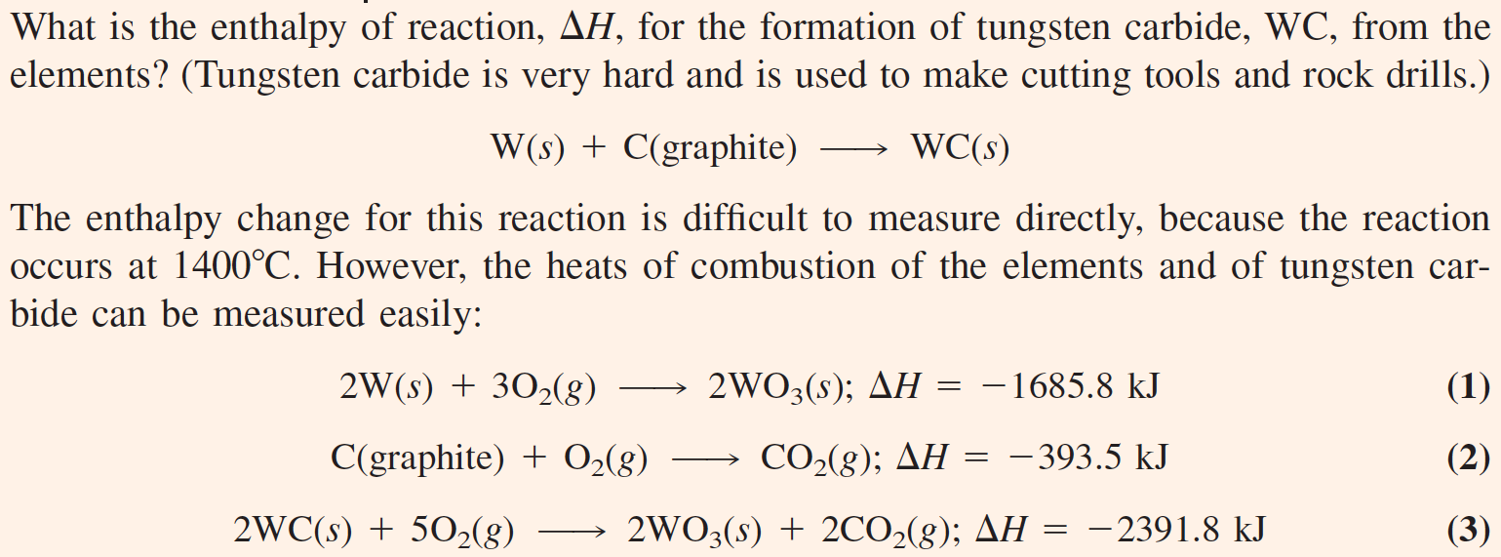
Applying Hess’s Law

Slide 33
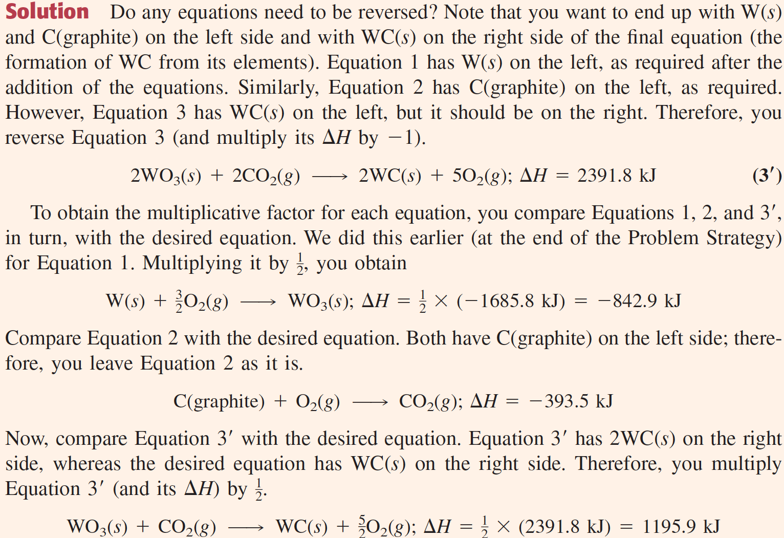

Slide 34
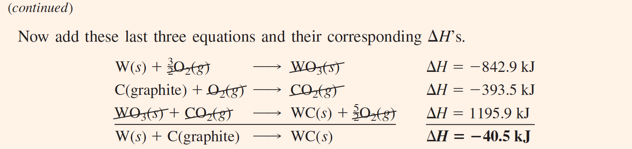

Slide 35
Standard Enthalpies of Formation
The term standard state refers to the standard thermodynamic conditions chosen for substances when listing or comparing thermodynamic data: 1 atm pressure and the specified temperature (usually 25°C).
The enthalpy change for a reaction in which reactants in their standard states yield products in their standard states is denoted ΔH°. The quantity ΔH° is called the standard enthalpy of reaction.
The standard enthalpy of formation (also called the standard heat of formation) of a substance, denoted !H"f, is the enthalpy change for
the formation of one mole of the substance in its standard state from its elements in their reference form and in their standard states.
The reference form of an element for the purpose of specifying the formation reaction is usually the stablest form (physical state and allotrope) of the element under standard thermodynamic conditions. The reference form of oxygen at 25°C is O2(g); the reference form of carbon at 25°C is graphite.

Slide 36
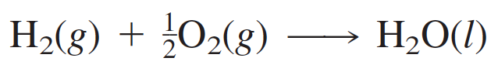
Equilibrium Constant for the Sum of Reactions
You write the formation reaction for 1 mol of liquid water as follows:
The standard enthalpy change for this reaction is −285.8 kJ per mole of H₂O. Therefore, the thermochemical equation is

Slide 37
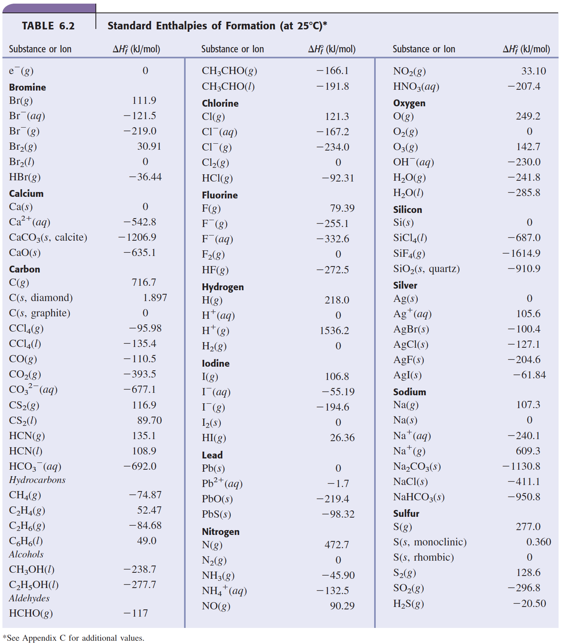

Slide 38
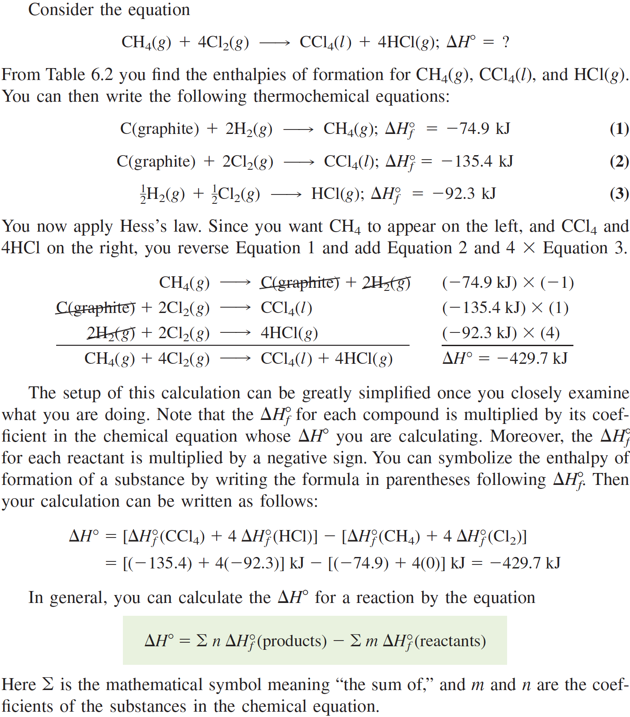

Slide 39
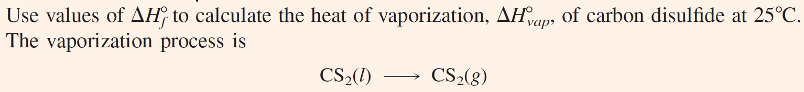
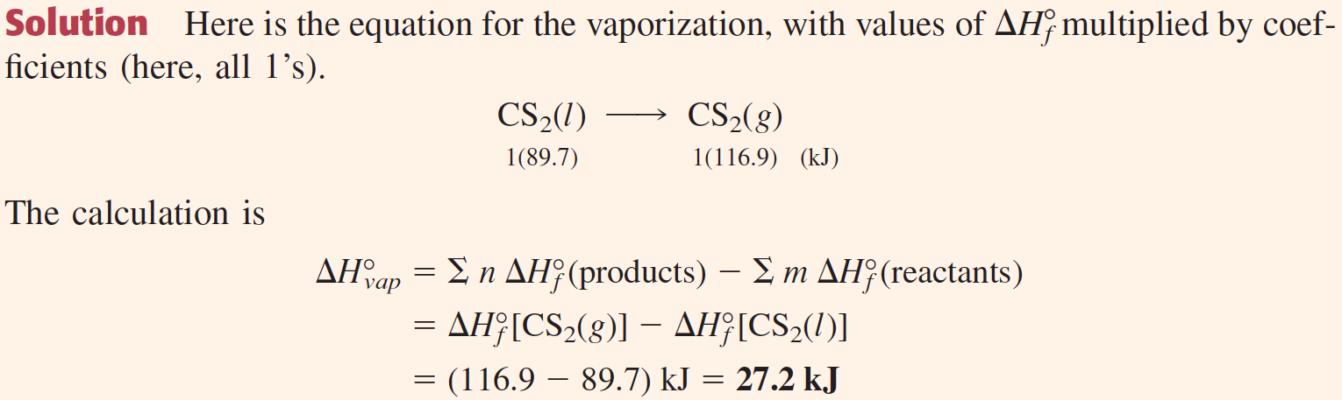

Slide 40
Foods as Fuels
Foods fill three needs of the body:
supply substances for the growth and repair of tissue
supply substances for the synthesis of compounds used in the regulation of body processes
supply energy (about 80% of the energy is for heat, rest is used for muscular action, chemical processes, and other body processes)
Combustion of glucose:
One gram of glucose yields 15.6 kJ (3.73 kcal) of heat when burned.
Combustion of a representative fat, glyceryl trimyristate, C₄₅H₈₆O₆:
One gram of this fat yields 38.5 kJ (9.20 kcal) of heat when burned.
The average values quoted for carbohydrates and fats are 4.0 kcal/g and 9.0 kcal/g, respectively.

Slide 41
Fossil Fuels
Fuel values of coals are rated in Btu’s (British thermal units, 1 Btu = 1054 J) per pound, which are essentially heats of combustion per pound of coal. A typical value is 13,200 Btu/lb (1 Btu/lb = 2.32 J/g). So, the combustion of coal in oxygen yields about 30.6 kJ/g.
Compare this value with the heat of combustion of pure carbon (graphite).
Combustion of Methane:
This value of ΔH° is equivalent to 50.1 kJ per gram of fuel.
Combustion of Octane:
This value of ΔH° is equivalent to 44.4 kJ/g.

Slide 42
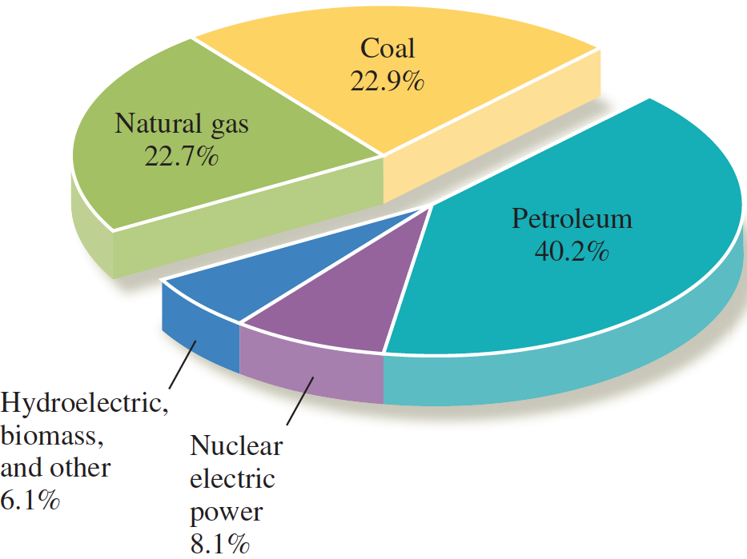
Sources of Energy Consumed

Slide 43
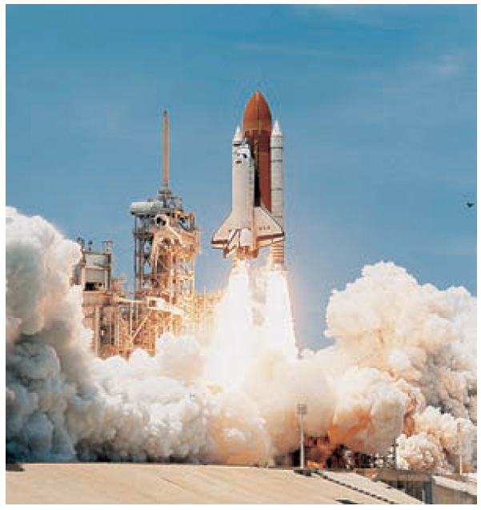
Rocket Fuels
This value of ΔH° is equivalent to 120 kJ/g of fuel (H₂) compared with 50 kJ/g of methane. The second and third stages of the Saturn V launch vehicle that sent a three man Apollo crew to the moon used a hydrogen/oxygen system. The launch vehicle contained liquid H₂ (boiling at −253°C) and liquid oxygen, or LOX (boiling at −183°C).

Slide 44
Rocket Fuels
The first stage of liftoff (Russian space shuttle) used kerosene and oxygen, and an unbelievable 550 metric tons (550 × 10³ kg) of kerosene were burned in 2.5 minutes! Kerosene is approximately C₁₂H₂₆. The thermochemical equation is
This value of ΔH° is equivalent to 44.1 kJ/g. Thus, 550 × 10⁶ g of fuel generated 2.43 × 10¹⁰ kJ in 150 s (2.5 min)
The landing module for the Apollo mission used a fuel made of hydrazine, N₂H₄, and a derivative of hydrazine. The oxidizer was dinitrogen tetroxide, N₂O₄. These substances are normally liquids and are therefore easier to store than liquid hydrogen and oxygen.

